Slide 1
Data Cleaning​ &
Model Proposal​
Shrey, Cameron, & Yoel

Slide 2
Is Race a Significant Predictor of CFR?
Data Cleaning
Best subsets on halves results
Best subsets overall results - ensure y-axis is rsq, not adjrsq
Residual plots, VIF
Interaction terms, transformations
Creating REDUCED Regression Model

Slide 3
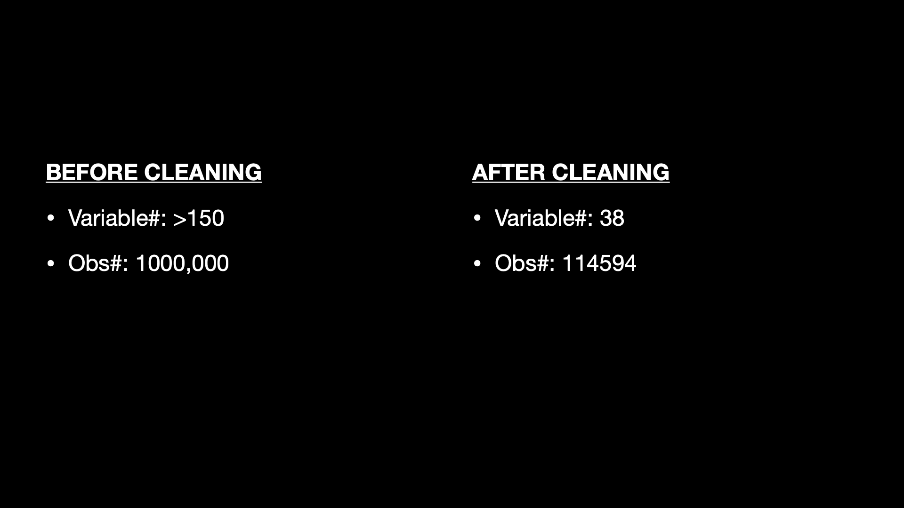
Data Cleaning
BEFORE CLEANING
AFTER CLEANING

Slide 4
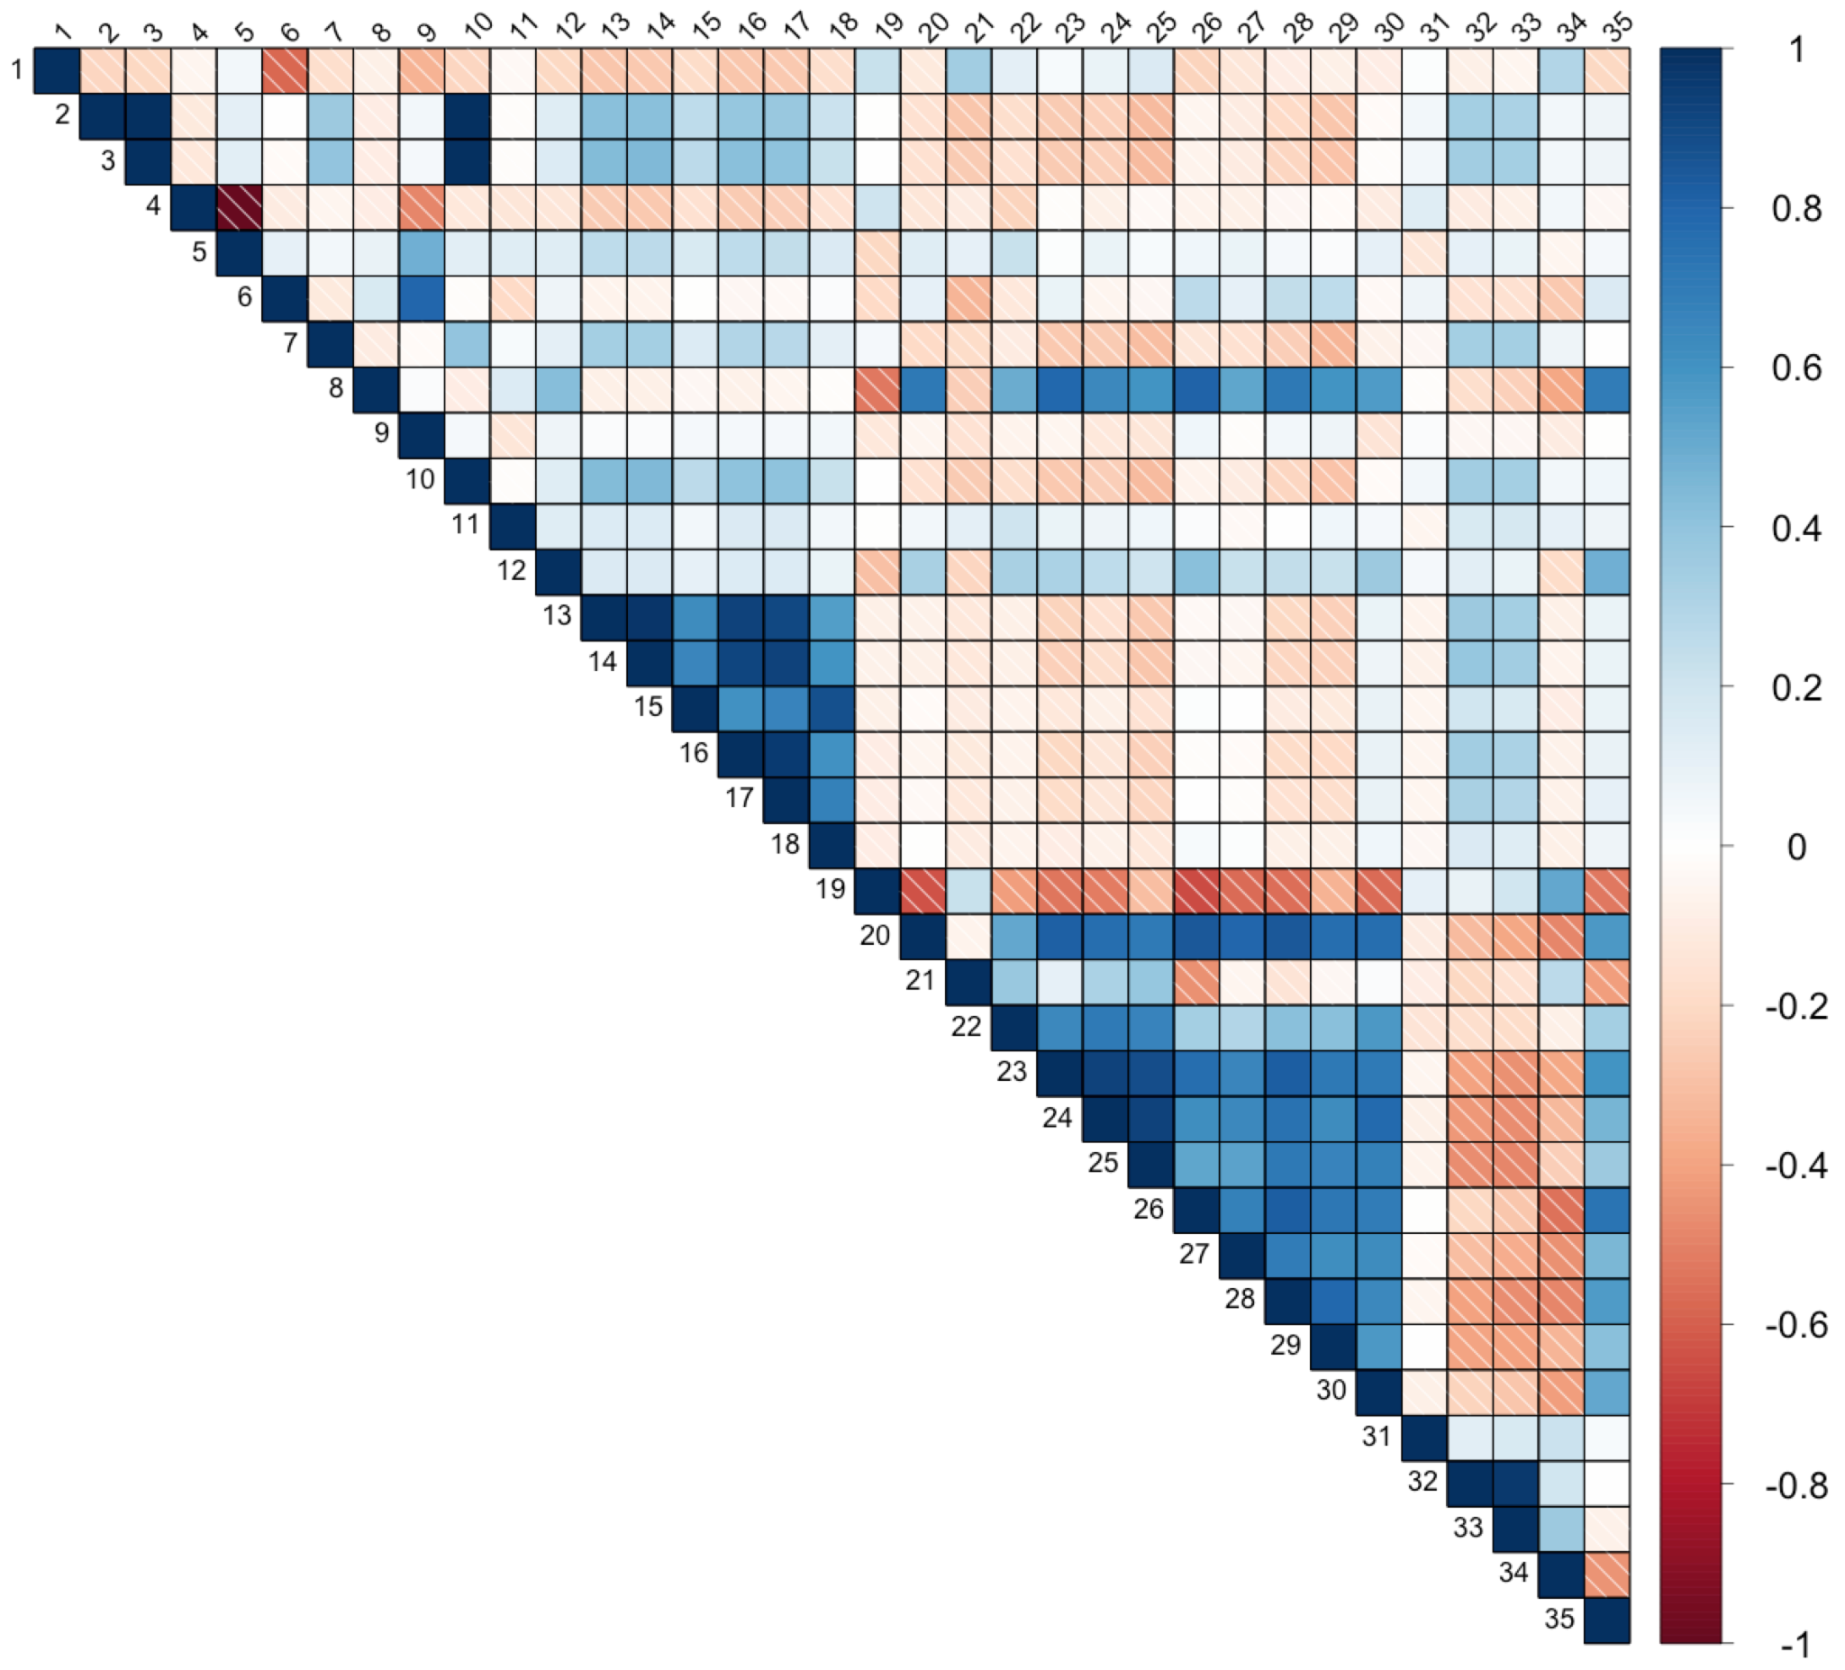
pop_over_65
population
housing_units
male
female
under18
commute
income_below_poverty
health_insur_coverage
household_income
edu_health_social_industry
unemployment_rate
all_adult_hospital_inpatient_beds_7_day_avg
all_adult_hospital_inpatient_bed_occupied_7_day_avg
total_adult_patients_hospitalized_confirmed_covid_7_day_avg
total_staffed_adult_icu_beds_7_day_avg
staffed_adult_icu_bed_occupancy_7_day_avg
staffed_icu_adult_patients_confirmed_covid_7_day_avg
binge
bphigh
cancer
casthma
chd
copd
csmoking
diabetes
highchol
lpa
obesity
sleep
Completeness_pct
Administered_Dose1_Pop_Pct
Series_Complete_Pop_Pct
Booster_Doses_Vax_Pct
Series_Complete_Pop_Pct_SVI

Slide 5
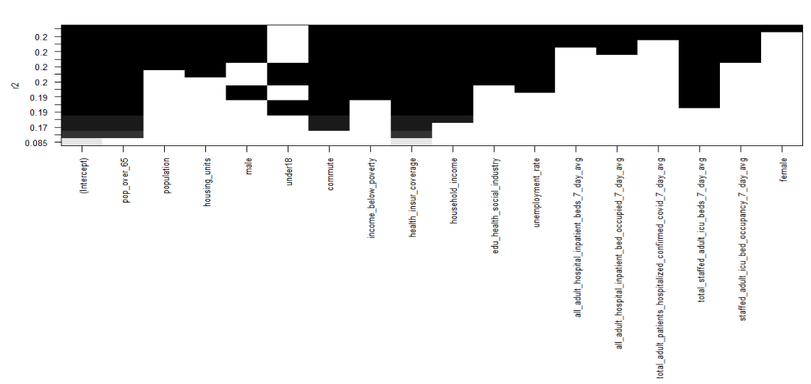
First Iteration of Best Subsets - first half
"pop_over_65"
"under18"
"commute"
"health_insur_coverage"
"household_income"
"male"
"income_below_poverty"
"total_staffed_adult_icu_beds_7_day_avg"

Slide 6
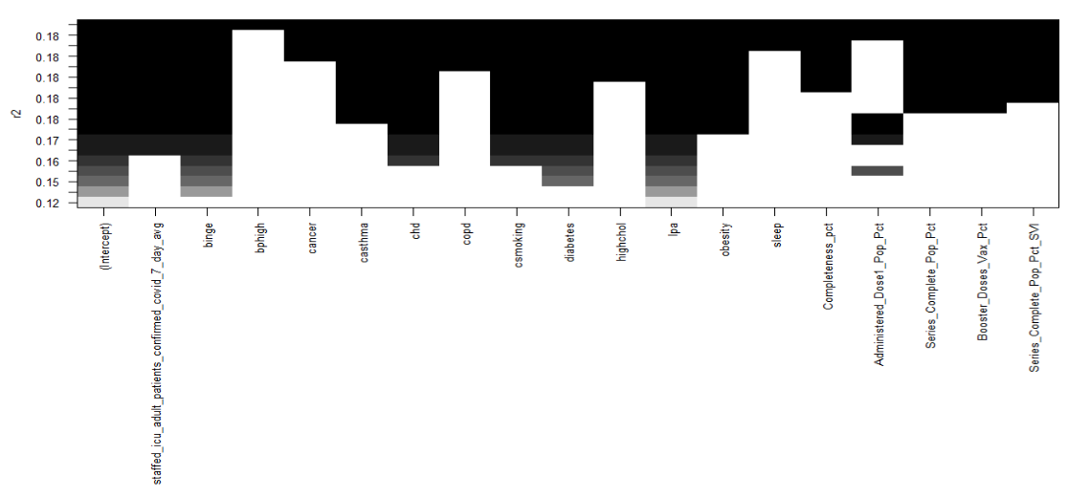
First Iteration of Best Subsets - second half
"Staffed_icu_adult_patients_confirmed_covid_7_day_avg", "Binge’, "casthma", "chd", "csmoking", "diabetes", "lpa", "obesity", "Administered_Dose1_Pop_Pct"

Slide 7
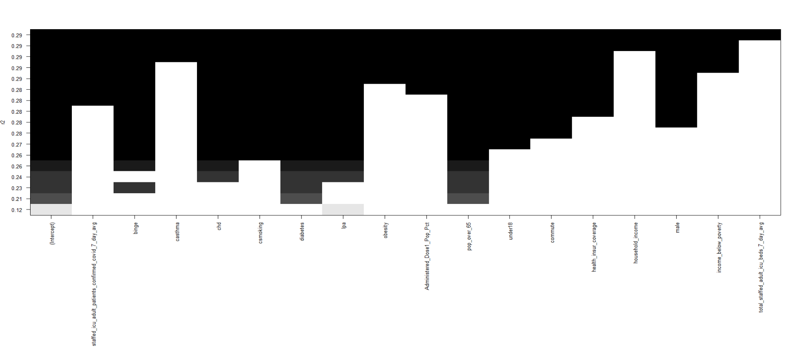
Final Best Subsets
Final selection: staffed_icu_adult_patients_confirmed_covid_7_day_avg, binge, chd, csmoking, diabetes, lpa, pop_over_65, under18, commute, health_insur_coverage, male

Slide 8
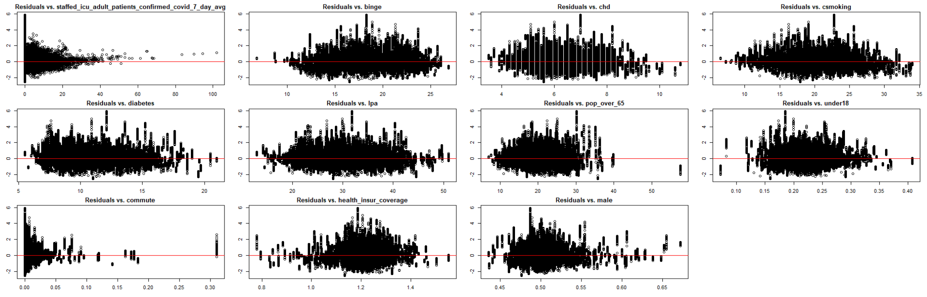
Residual Plots for each variable

Slide 9
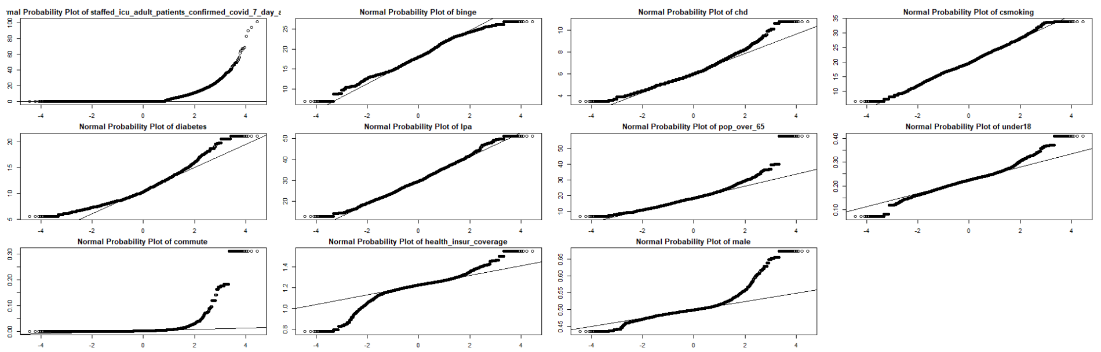
Normal Probability Plots for each variable

Slide 10
Necessary Transformations
Log transformations applied:
commute
staffed hospital beds
Quadratic transformation applied (tentative)
Health insurance coverage

Slide 11
Improvement on Model
staffed_icu_adult_patients_confirmed_covid_7_day_avg, binge, chd, csmoking, diabetes, lpa, pop_over_65, under18, commute, health_insur_coverage, male
Call:
lm(formula = CFR ~ binge + chd + csmoking + diabetes + lpa +
male + pop_over_65 + under18 + health_insur_coverage + log_commute +
log_staffed_icu, data = regfin2)
Residual standard error: 0.5037 on 24888 degrees of freedom
Multiple R-squared: 0.3596, Adjusted R-squared: 0.3593
F-statistic: 1270 on 11 and 24888 DF, p-value: < 2.2e-16

Slide 12
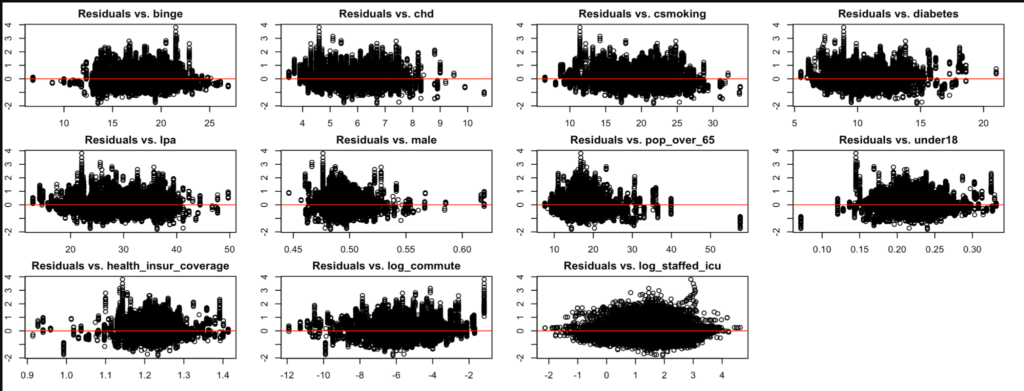
Resid plots after log transformation

Slide 13
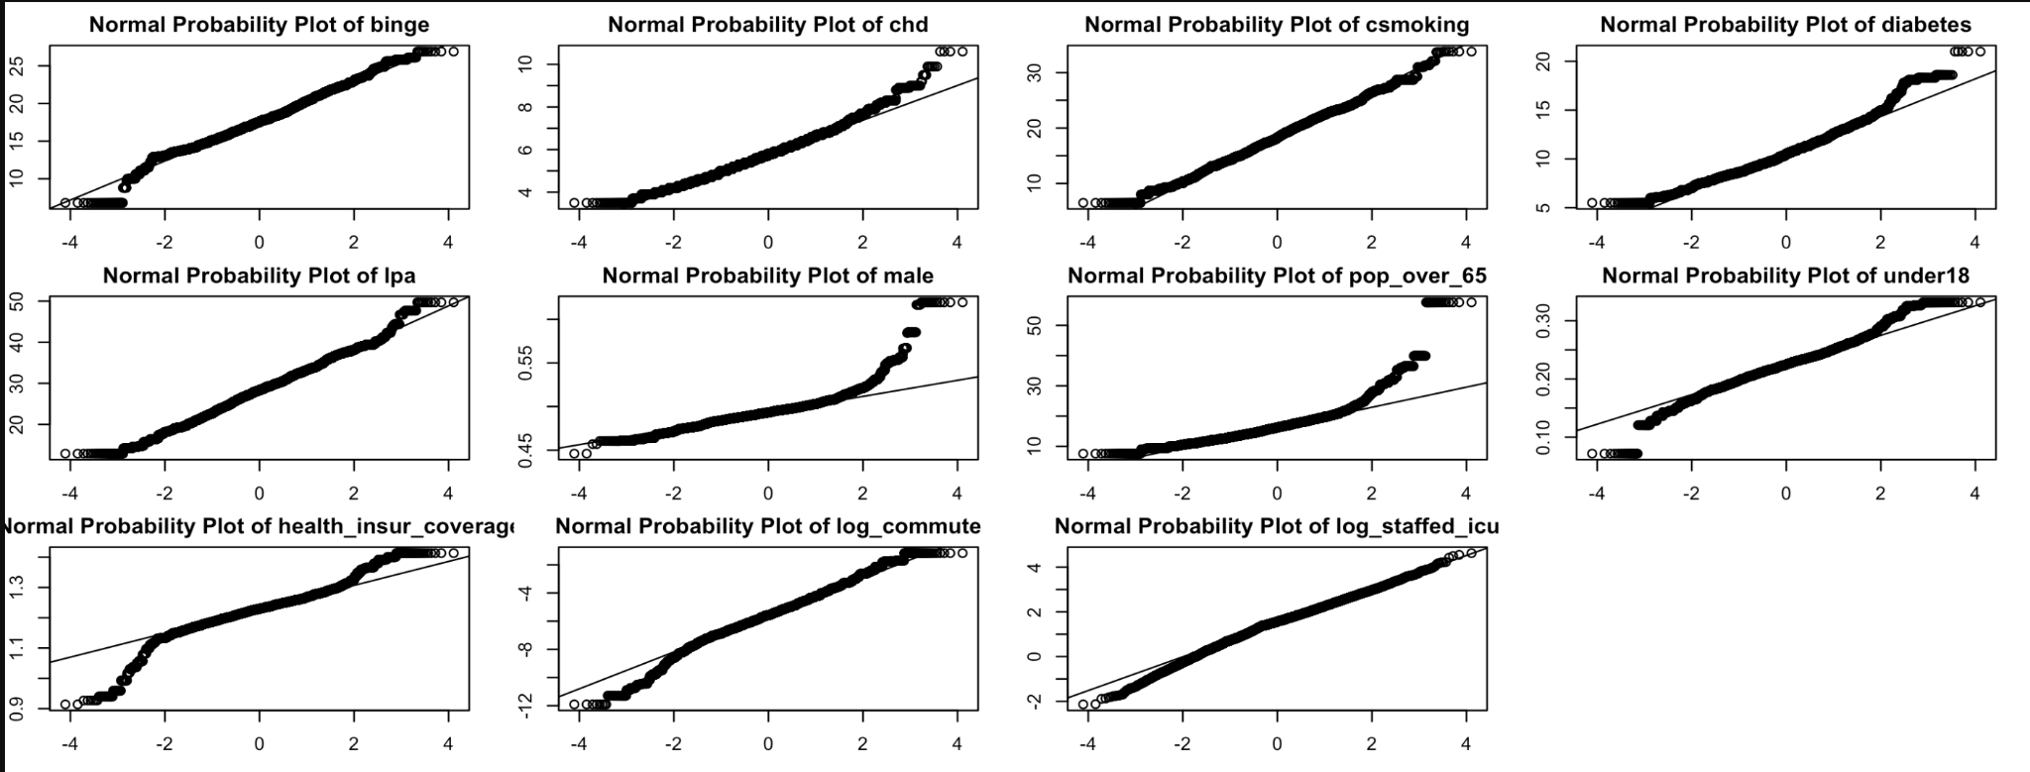
NPP after log transformation

Slide 14
